Slide 1
Today I will be introducing our research project: “Food Around the World”

Slide 2
Food Around the World
Today’s Learning Targets:
Students will….
*understand the meaning of culture, customs and traditions.
*compare & contrast Canadian table manners with other countries around the world.
*choose a country of interest to study its customs & traditions associated with foods & eating habits.

Slide 3
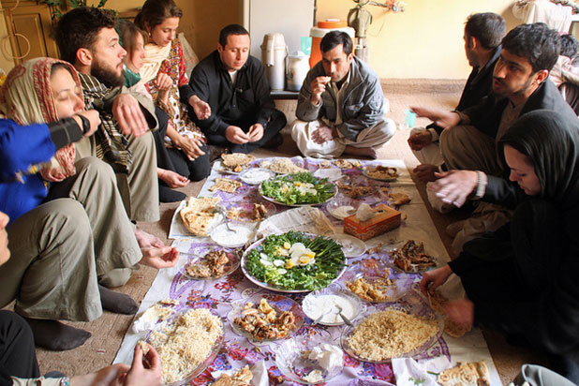
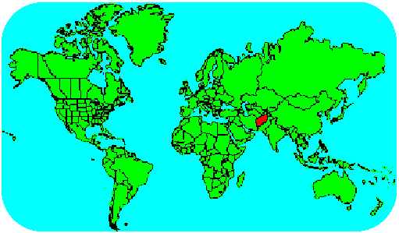
Afghanistan
Table manners in Afghanistan state that guests are supposed to eat first, eat the most, and should be seated furthest from the door. Guests who accidentally drop their bread should pick it up, kiss it, and raise it to their foreheads before setting it back down. Also, food is only eaten with the right hand, because the left hand has a disgraced reputation for its involvement with bathroom related activities.
http://www.thedailymeal.com/unexpected-table-manners-around-world-slideshow-5#nogo#ixzz1HSYGPIkz

Slide 4
Foods Around the World Rubric
 | 4 | 3 | 2 | 1
Content | Cookbook contains all relevant information. | Cookbook is missing one piece of information. | Cookbook is missing 2 or more pieces of information. | Cookbook is missing most of the relevant information.
Writing Conventions | Student used correct grammar, correct spelling and punctuation? | Student has very few grammar, spelling or punctuation errors | Student has many grammar, spelling & punctuation errors. | Student did not proofread cookbook and turned in with multiple errors.
Design | Cookbook is easy to read, pages are pleasing to look at, and student used appropriate graphics to enhance pages. | Cookbook is designed fairly well. | Cookbook is cluttered. | Cookbook is not finished.
Content Required:
The name and picture of your country, its flag.
Some of your country’s traditional dinner table etiquette (manners)?
Common foods eaten at breakfast, lunch and/or dinner.
Breakfast, lunch, & dinner in your country’s native language. (if applicable)
Interesting fact having to do with foods, eating, table manners.
Recipe Page: Name of country, name of recipe, picture of dish, ingredients and directions. This page will be going into a Cookbook!

Slide 5
This assignment is due on the last day of class. Please send it to:
jurudolph@educbe.ca

